Slide 1

STANDARD CHARTERED BANK
AI/ML Driven 360° Client Intelligence
Presented by: [Your Name], [Your Role] in the AI/ML Project Team

Slide 2
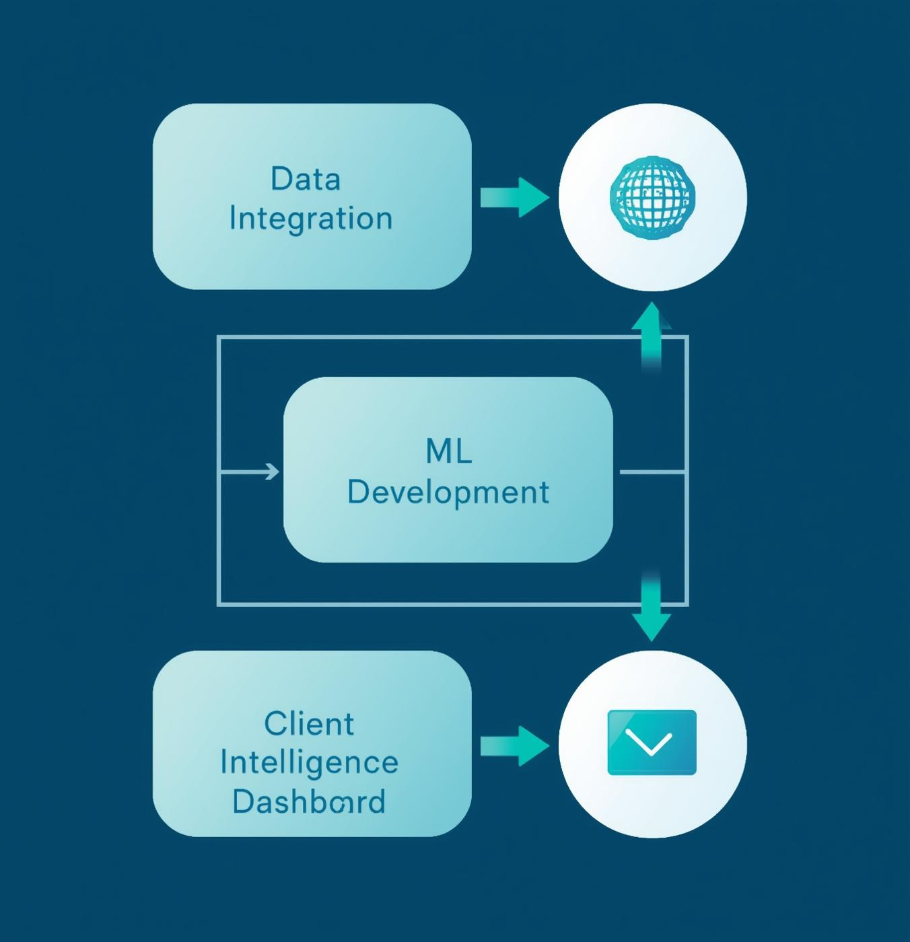
Project Objective
This section outlines the primary objectives of the AI/ML Driven 360° Client Intelligence project. It aims to integrate extensive datasets, establish robust ML and LLM pipelines, and ultimately deliver a comprehensive 360° client intelligence dashboard for enhanced decision-making.

Slide 3
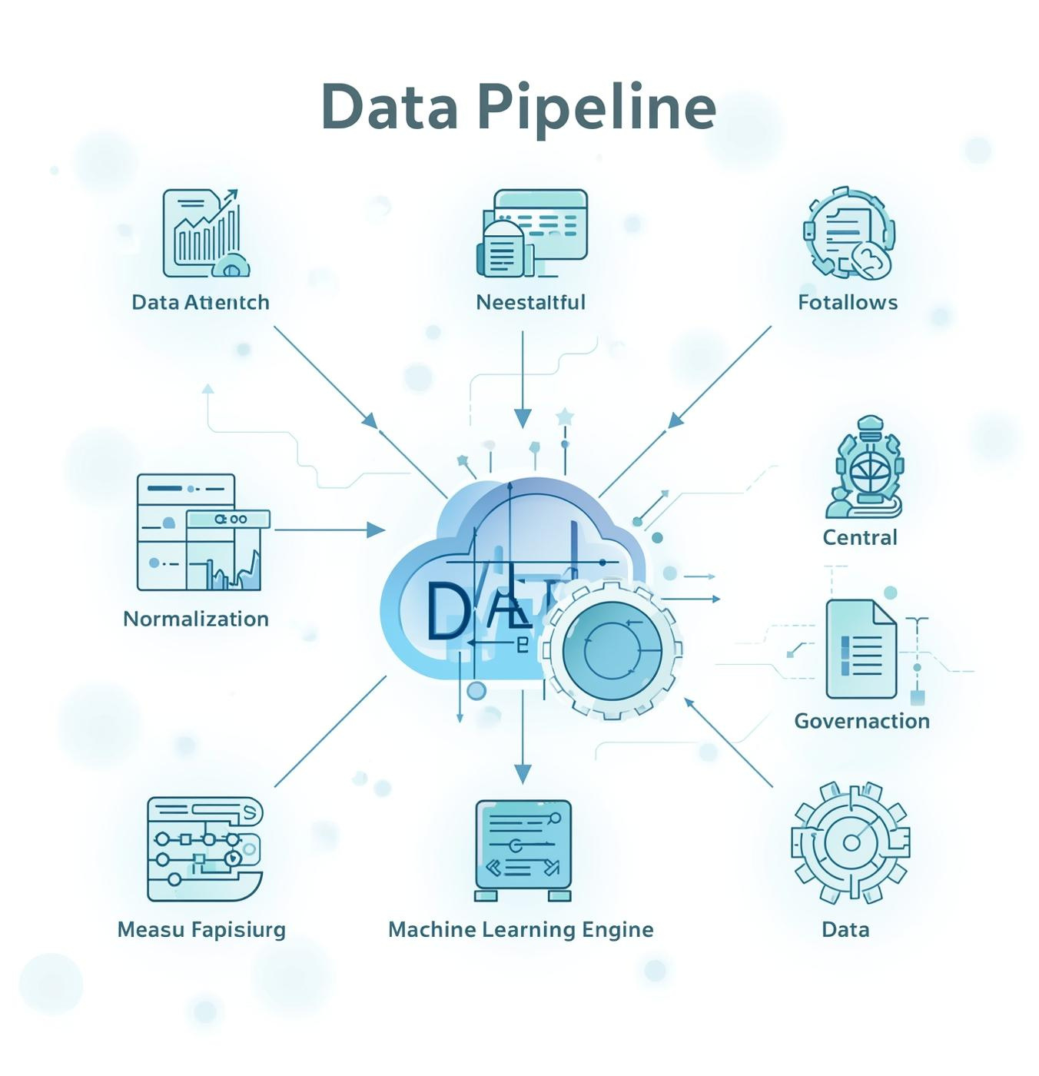
Data Architecture
This section illustrates the data flow from various sources into a centralized data lake, showcasing the ingestion, normalization, and metadata processes. It emphasizes the critical role of governance in ensuring data integrity and availability for machine learning applications.

Slide 4
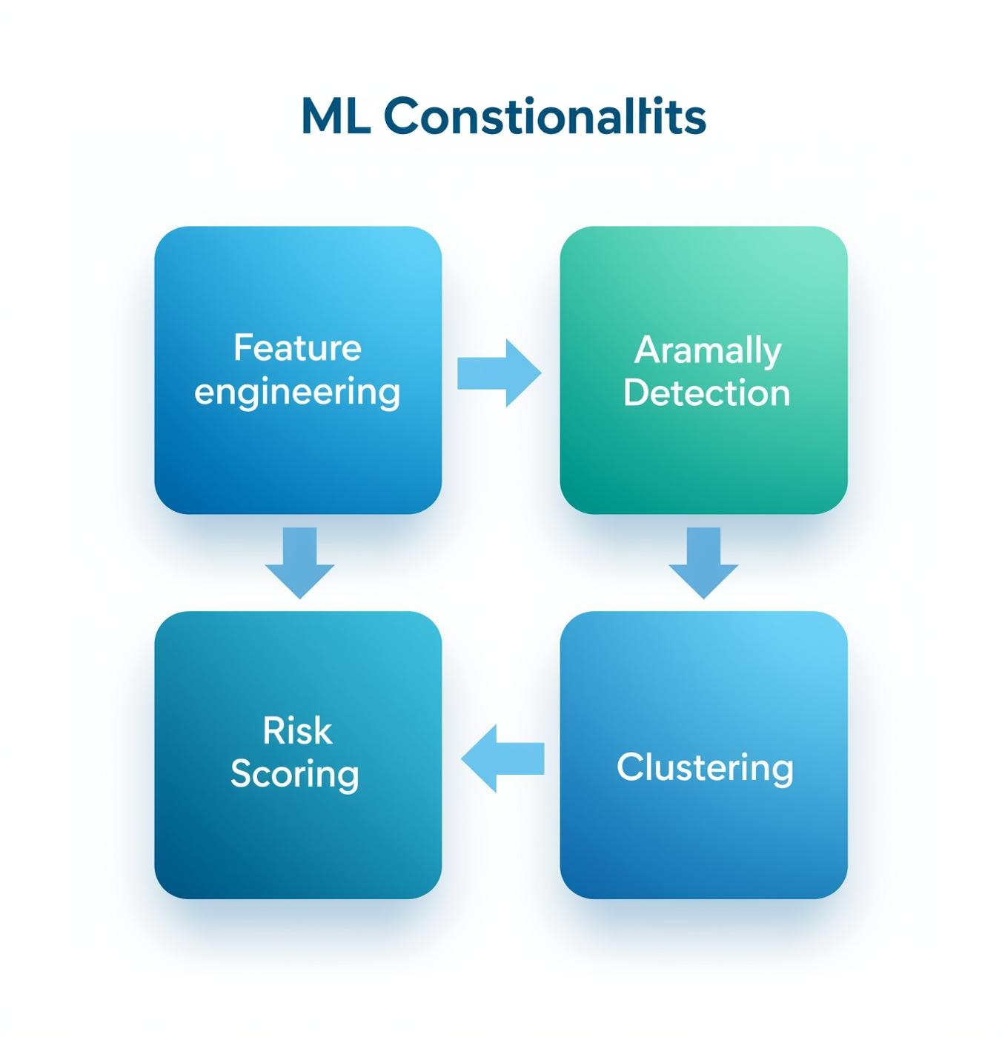
ML Engine Components
The ML Engine is fundamental for driving insights from the data pipeline. It encompasses feature engineering, anomaly detection, risk scoring, and clustering, ensuring a robust framework for analytics that enhances decision-making processes and client intelligence capabilities.

Slide 5
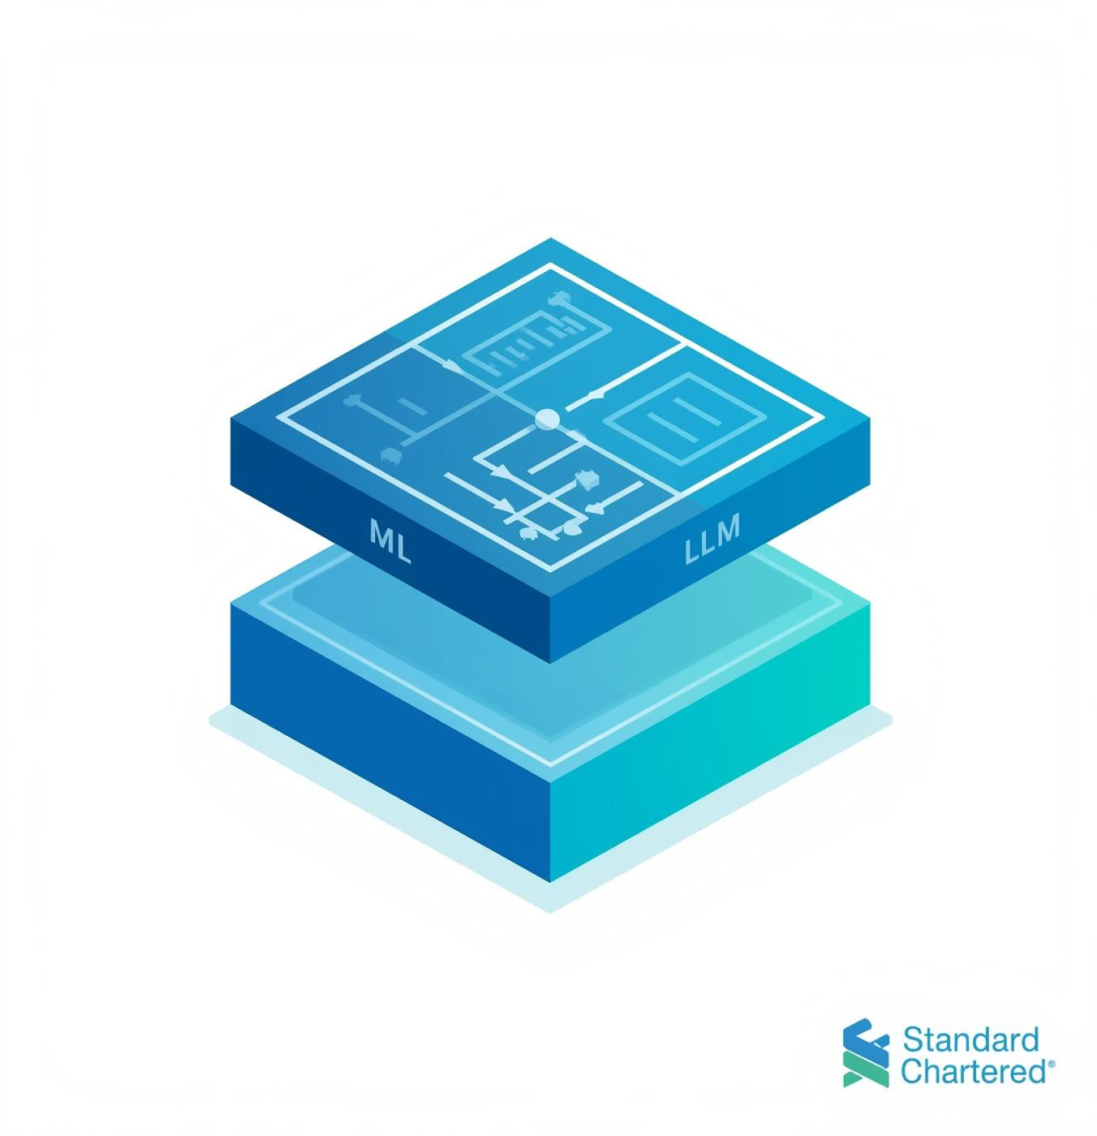
AI / LLM Integration
This section outlines the integration of AI and LLM technologies on top of the machine learning outputs. Leveraging LangChain and GPT-5, we enhance insights and ensure explainability through SHAP, along with automated narratives and natural-language data queries for improved user interaction.

Slide 6
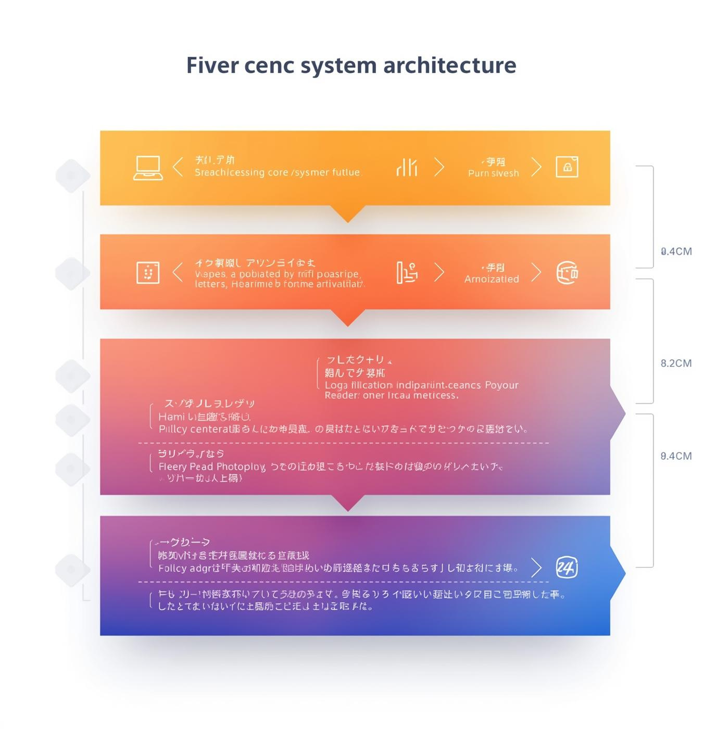
Combined System Architecture
This section outlines the end-to-end architecture of the AI/ML Driven 360° Client Intelligence system. It showcases how unified data flows through the layers of machine learning and AI, culminating in a comprehensive client intelligence dashboard while ensuring governance and explainability.

Slide 7



Technical Use Cases Overview
01
03
02
Credit
Segmentation
Evaluating potential credit risk for clients effectively.
Classifying clients for tailored financial solutions.
Anomaly
Identifying unusual patterns in financial transactions.

Slide 8
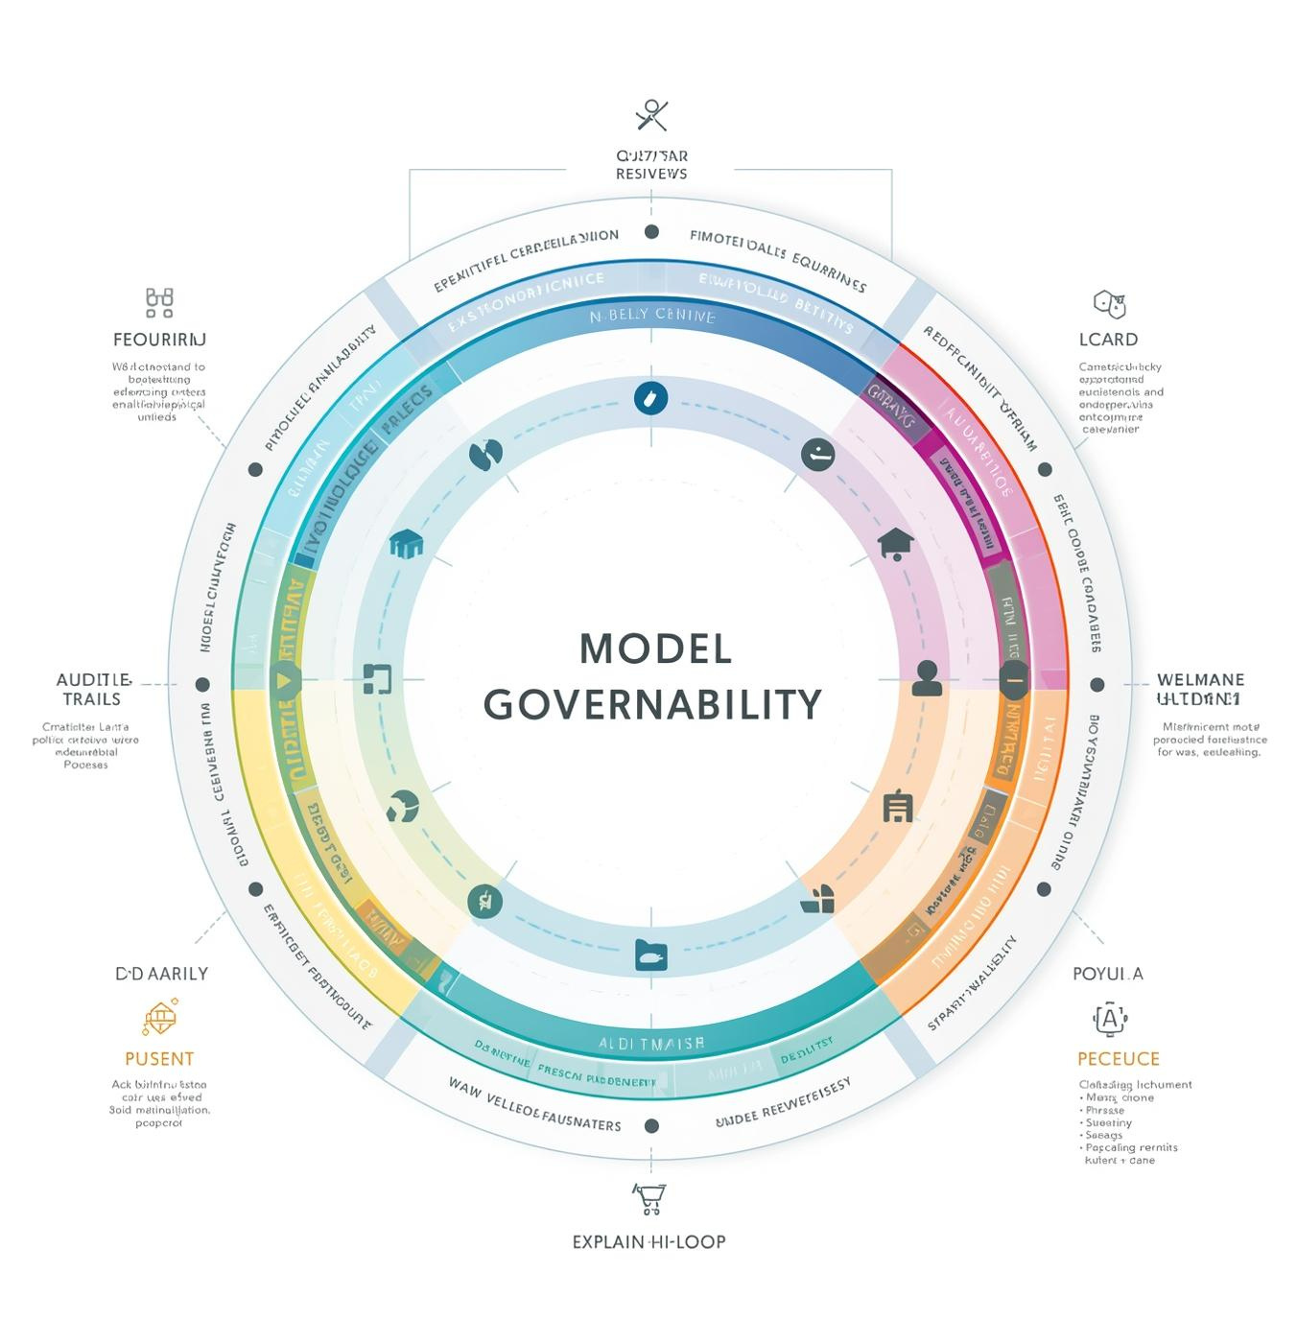
Model Governance
Implementing a robust governance framework is crucial for overseeing AI model performance and ensuring compliance. This involves model versioning, creating an audit trail, and incorporating explainability techniques such as SHAP, which reinforces trust and accountability in AI-driven decisions.

Slide 9
Implementation Roadmap
Integration
Begin data integration process.
Pipeline
Develop ML pipeline framework.
Launch
Initiate LLM integration phase.

Slide 10

Technical Summary
This slide encapsulates the synergy of our unified AI/ML architecture, highlighting the significance of explainable AI and continuous learning. It emphasizes how our integrated approach ensures effective client intelligence and robust decision-making for Standard Chartered Bank.

Slide 11


Let's Connect and Collaborate!
EMAIL
SOCIAL MEDIA
PHONE
hello@reallygreatsite.com
@reallygreatsite
123-456-7890

